Slide 1
AWS – ELB & Auto Scaling Group
By
Keshav Kummari

Slide 2
Elastic Load Balancer
A load balancer can distribute incoming traffic across your EC2 instances.
This enables you to increase the availability of your application.
The load balancer also monitors the health of its registered instances and ensures that it routes traffic only to healthy instances.
You configure your load balancer to accept incoming traffic by specifying one or more listeners, which are configured with a protocol and port number for connections from clients to the load balancer and a protocol and port number for connections from the load balancer to the instances.
Elastic Load Balancing supports three types of load balancers: Application Load Balancers, Network Load Balancers, and Classic Load Balancers.
All Elastic Load Balancing operations are idempotent , which means that they complete at most one time.
If you repeat an operation, it succeeds with a 200 OK response code.

Slide 3
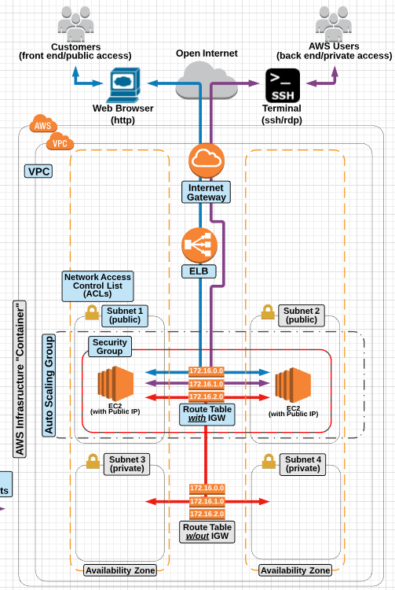

Slide 4
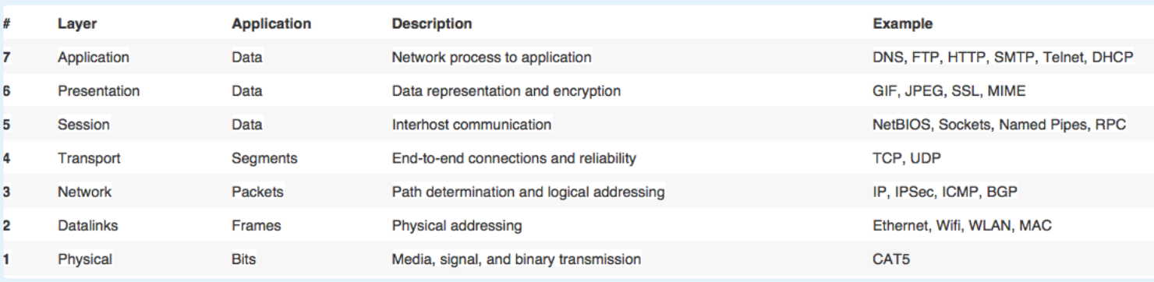
OSI (Open Systems Interconnection) 7 Layer Model

Slide 5
Elastic Load Balancer(ELB)
Load Balancing is a common method used for distributing incoming traffic among servers.
An Elastic Load Balancer is an EC2 service that automates the process of distributing incoming traffic to all the instances that are associated with the ELB.
Cross-Zone load balancing :
An elastic load balancer can load balance traffic to instances located across multiple availability zones.
This allows for highly availability and fault tolerant architecture.
Elastic load balancing can be paired with Auto Scaling to enhance high availability and fault tolerance, and allow for automated scalability and elasticity.
An ELB has it’s own DNS record set that allows for direct access from the open internet access.
Important ELB Facts:
An ELB can be public-facing or used as an internal load balancer and load balancer to internal EC2 instances on Private Subnets(As often done with Multi-Tier Applications).
ELB’s will automatically stop serving traffic to an instance that becomes unhealthy(Via healthy checks)
An ELB or ALB can help reduce compute power or an EC2 instance by allowing for an SSL certificate to be applied directly to the elastic load balancer.

Slide 6
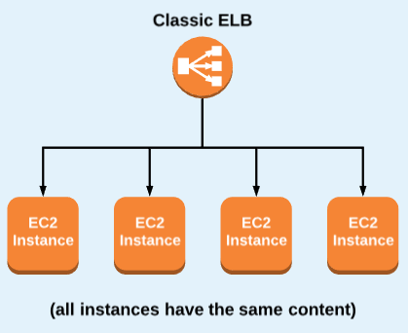
Classic Elastic Load Balancer – OSI Layer 4
A “Classic” Elastic Load Balancer is designed for SIMPLE balancing of traffic to multiple EC2 instances.
There are no granular routing “rules” – all instances get routed to evenly, and no special routing request can be made based on specific content request from the user.
Protocols : TCP, SSL HTTP, HTTPS

Slide 7
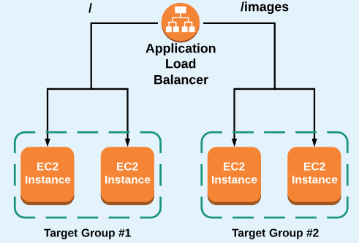
Application Elastic Load Balancer – OSI Layer 7
An application load balancer is designed for balancing of traffic to one or more instance target grows using Content-based “rules”.
Content-based rules(setup on the listener) can be configured using:
Host-based rules: Route traffic based on the host field of the HTTP header
Path-based rules: Route traffic based on the URL path of the HTTP header
This allows you to structure your application as smaller services, and even monitor/auto-scale based on traffic to specific “target groups”.
Can balance traffic to multiple ports
An application Load balancer also supports :
ECS and EKS, HTTPS, HTTP/2,
Web Sockets, Access Logs, Sticky Sessions,
and AWS WAF(Web Application Firewall).

Slide 8
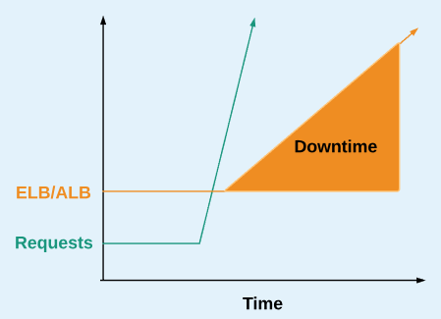
Network Elastic Load Balancer – OSI Layer 3
The Network Load Balancer is designed for extreme performance.
It does not need to scale to handle large traffic spikes.
Layer 4 (TCP) load balancing
Static / Elastic IP address per AZ
IP Addresses as Targets
No SSL Offloading

Slide 9
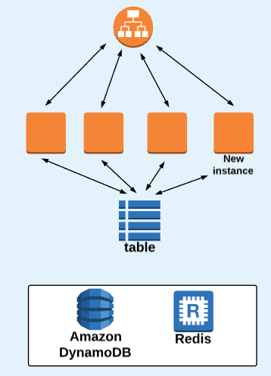
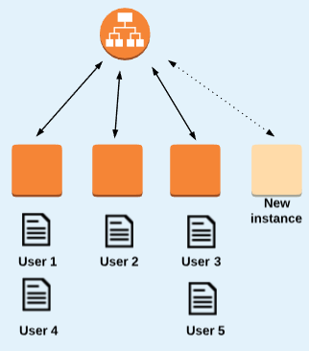
Stateless Architecture
Store State information Off-Instance
NoSQL Database
Shared FileSystem

Slide 10
AWS ELB CLI Commands List https://docs.aws.amazon.com/cli/latest/reference/elb/index.html
add-tags
apply-security-groups-to-load-balancer
attach-load-balancer-to-subnets
configure-health-check
create-app-cookie-stickiness-policy
create-lb-cookie-stickiness-policy
create-load-balancer
create-load-balancer-listeners
create-load-balancer-policy
delete-load-balancer
delete-load-balancer-listeners
delete-load-balancer-policy
deregister-instances-from-load-balancer
describe-account-limits
describe-instance-health
describe-load-balancer-attributes
describe-load-balancer-policies
describe-load-balancer-policy-types
describe-load-balancers
describe-tags
detach-load-balancer-from-subnets
disable-availability-zones-for-load-balancer
enable-availability-zones-for-load-balancer
modify-load-balancer-attributes
register-instances-with-load-balancer
remove-tags
set-load-balancer-listener-ssl-certificate
set-load-balancer-policies-for-backend-server
set-load-balancer-policies-of-listener
wait

Slide 11
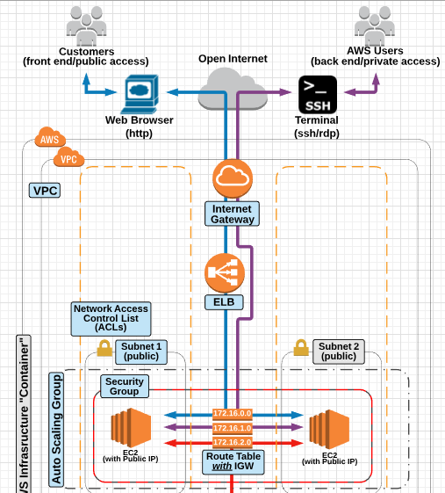
Create Classic Elastic Load Balancer

Slide 12
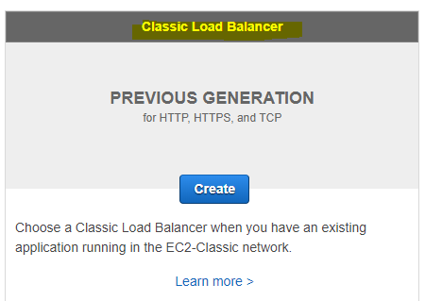
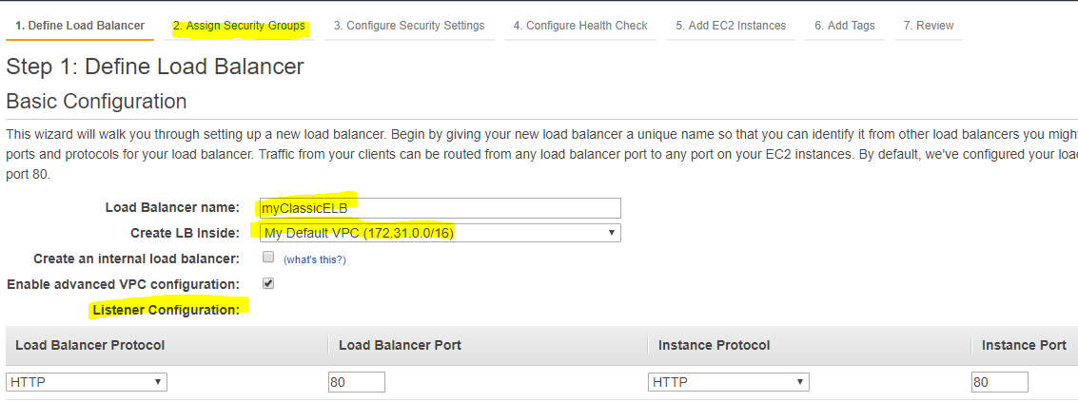
Step-1 Create Classic ELB

Slide 13
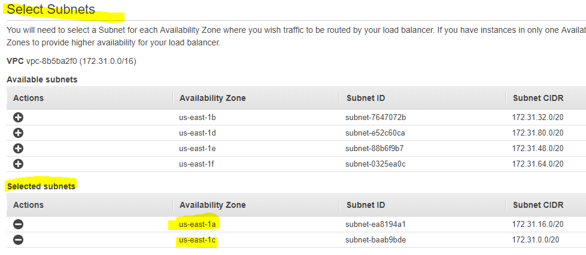
Step-2 : Select Subnets

Slide 14
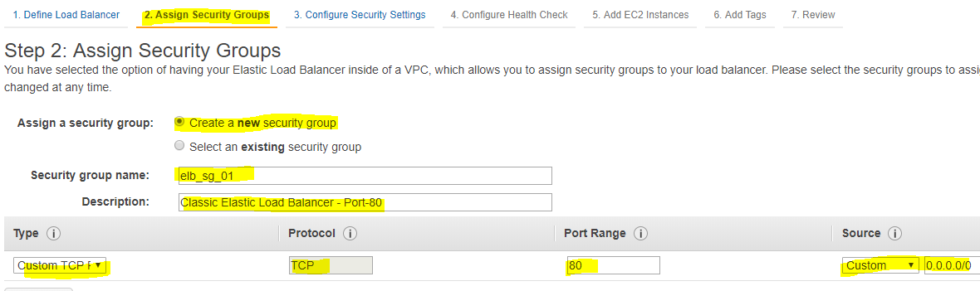
Step-3 : Create Security Groups on Port 80 and assign

Slide 15
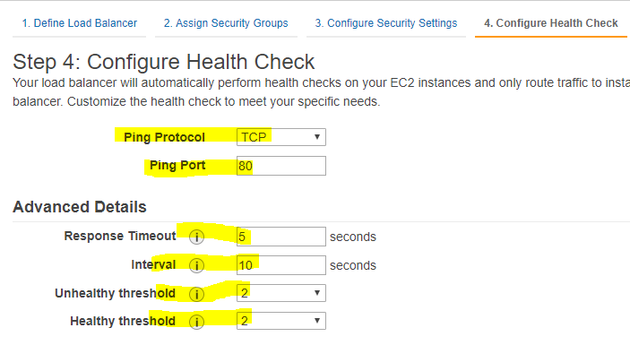
Step-4 : Configure Health Check

Slide 16
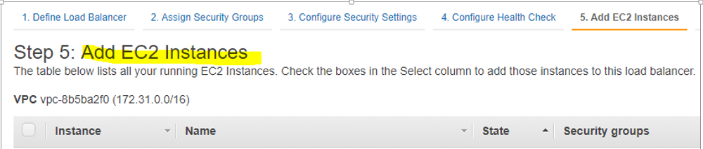
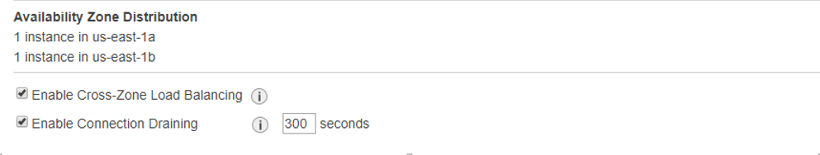
Step-5 : Add EC2 instances to Elastic Load Balancer using Manual or Auto Scaling

Slide 17
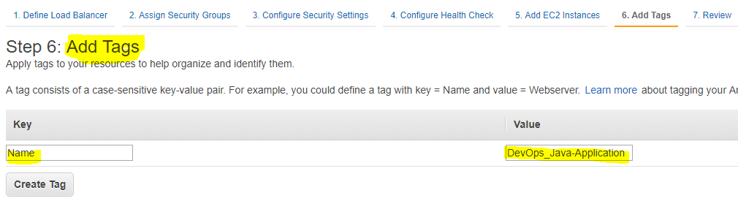
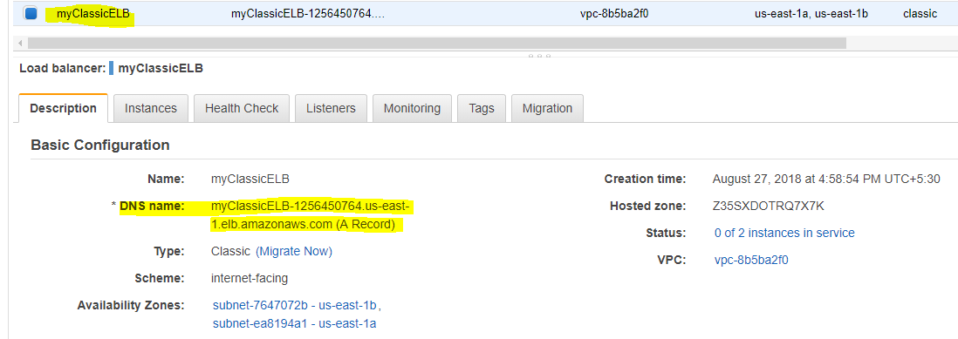
Step-6 : Add Tags & Click on Create

Slide 18
Cross check the ELB, EC2 instance configuration
Go to Browser and verify the ELB DNS Name
http://myclassicelb-1256450764.us-east-1.elb.amazonaws.com/

Slide 19
Auto Scaling Overview
Auto Scaling provides the ability to ensure a correct number of EC2 instances are always running to handle the load of the application
Auto Scaling helps to achieve better fault tolerance, better availability and cost management
Auto Scaling also helps specify Scaling policies which can the be used to launch and terminate EC2 instances to handle any increase or decrease in demand on the application.
Auto Scaling attempts to distribute instances evenly between the AZs that are enabled for the Auto Scaling group.
Auto Scaling does this by attempting to launch new instances in the AZ with the fewest instances. If the attempt fails, Auto Scaling attempts to launch the instances in another Availability Zone until it succeeds

Slide 20
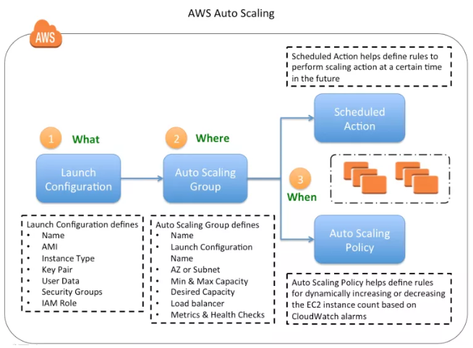

Slide 21
Launch Configuration
Launch configuration is a template that an Auto Scaling group uses to launch EC2 instances.
Launch configuration is similar to EC2 configuration and involves selection of the Amazon Machine Image (AMI), the instance type, a key pair, one or more security groups, and a block device mapping.
Launch configuration can be associated multiple Auto Scaling groups
Launch configuration can’t be modified after creation and needs to be created new if any modification required
Basic or Detailed monitoring for the instances in the Auto Scaling group can be enabled when a launch configuration is created.
By default, basic monitoring is enabled when you create the launch configuration using the AWS Management Console and detailed monitoring is enabled when you create the launch configuration using the AWS CLI or an API

Slide 22
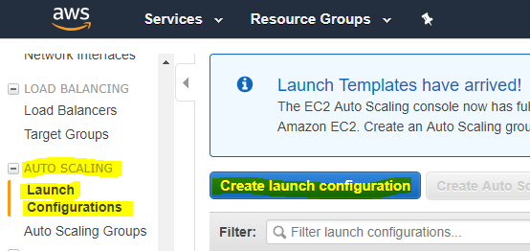
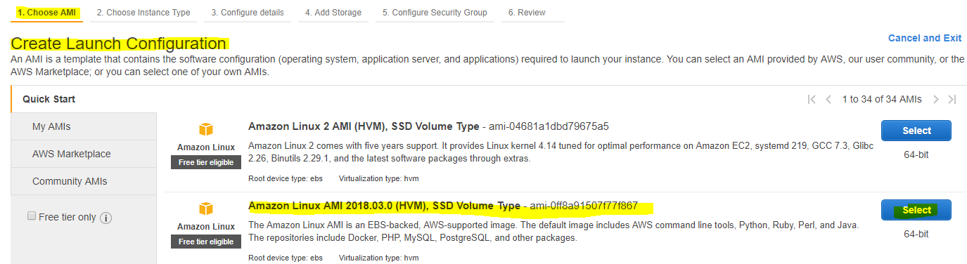
Auto Scaling Group & Launch Configuration

Slide 23
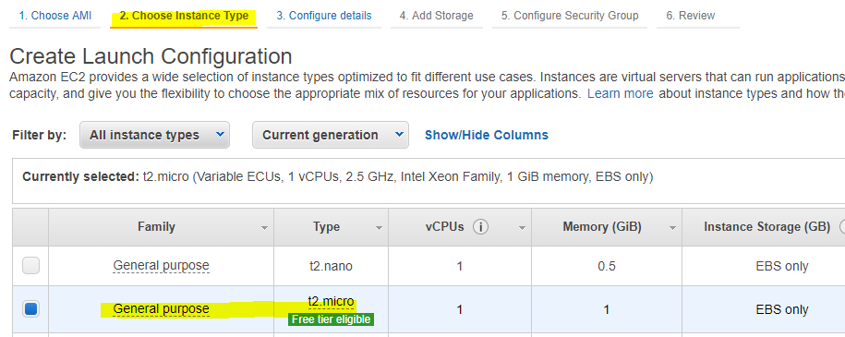
Select the Instance Type

Slide 24
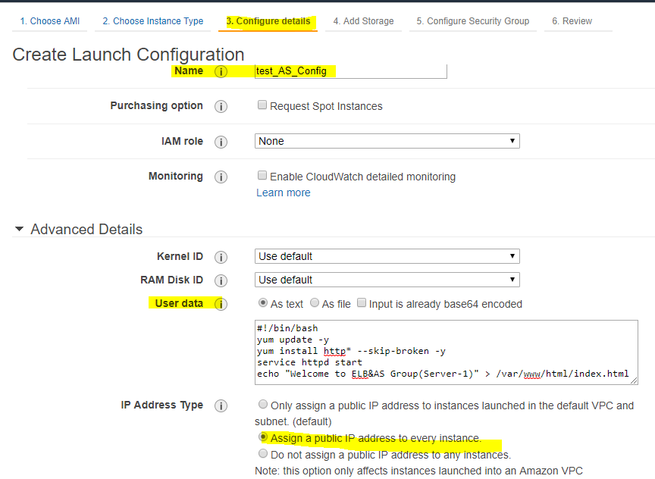
Configure the Bootstrap Script

Slide 25
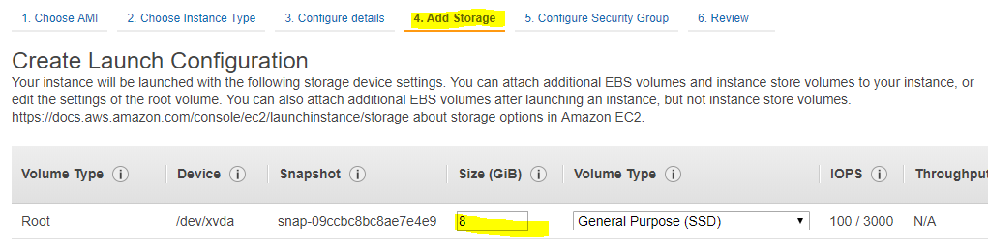
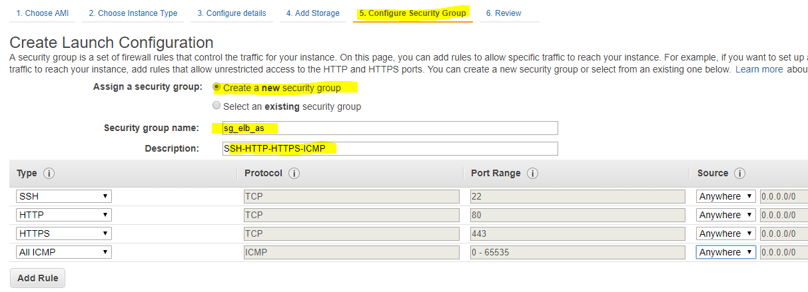
Add Storage & Create Security Group

Slide 26
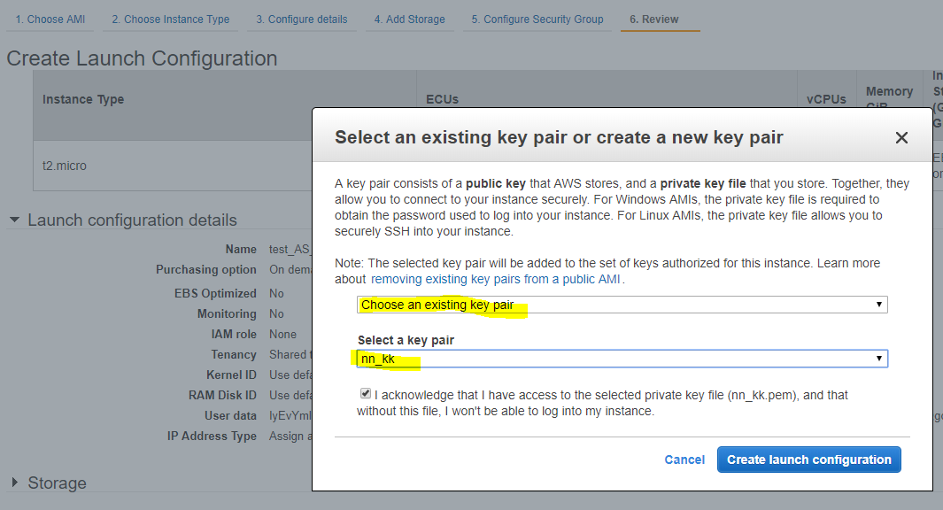
Select the Keypair and Click on Create

Slide 27
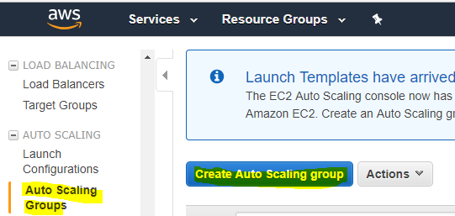
Now, Auto Scaling Group Creation Process

Slide 28
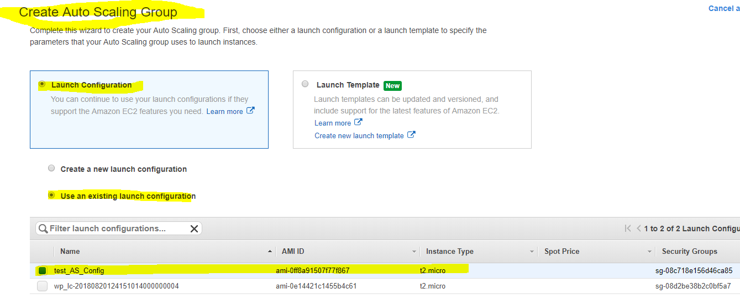

Slide 29
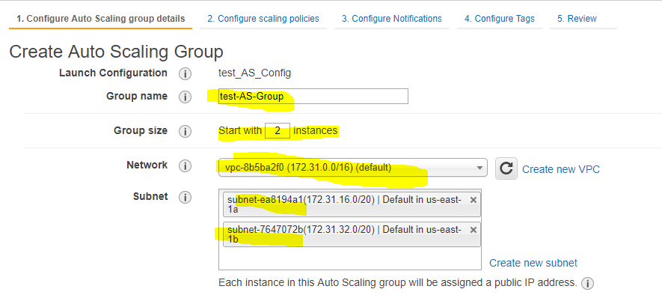

Slide 30
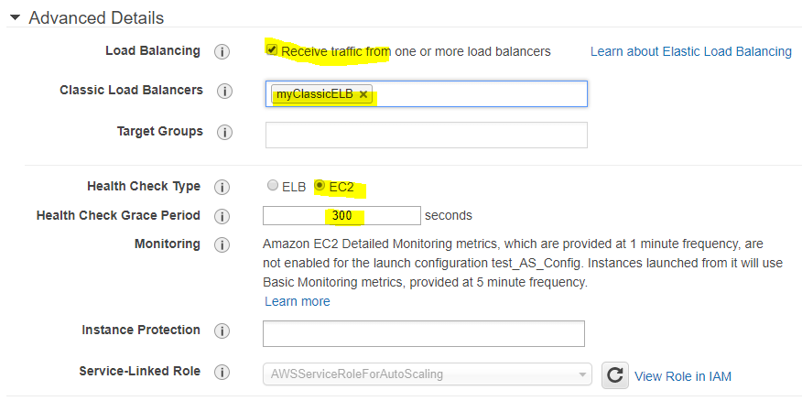

Slide 31
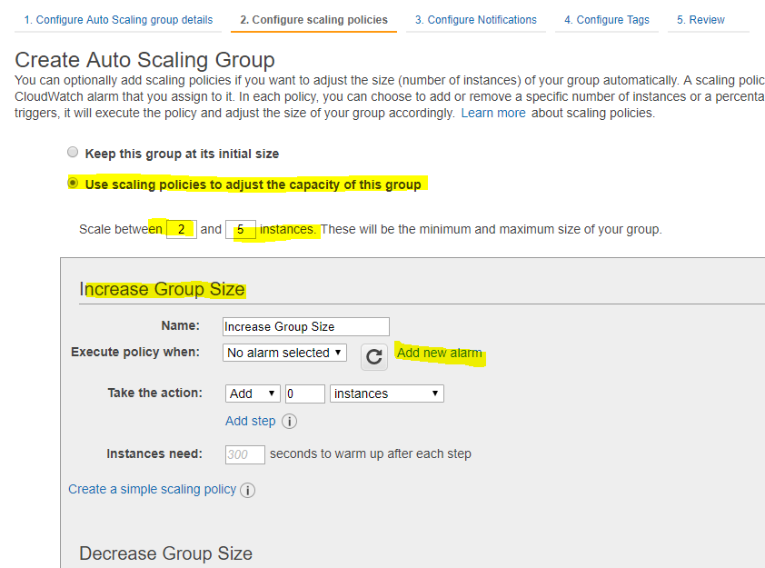

Slide 32
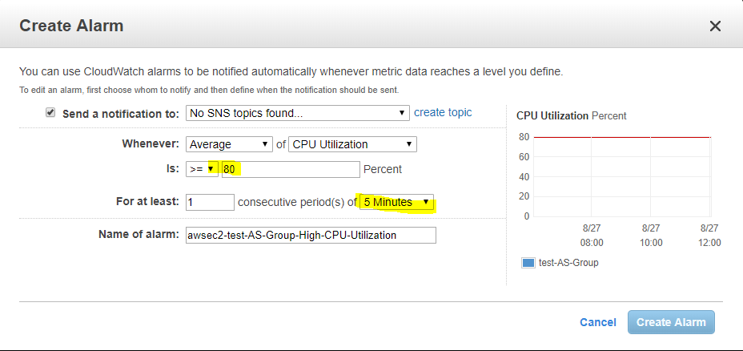
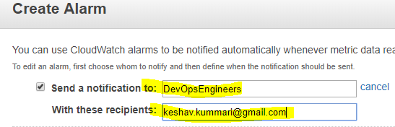

Slide 33
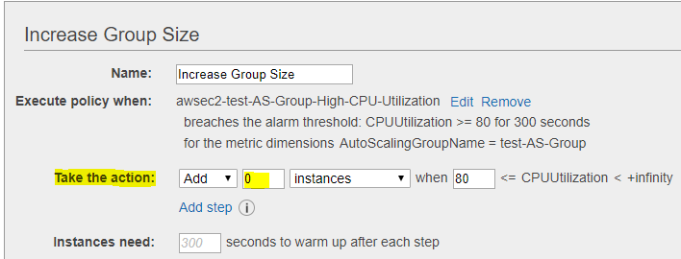
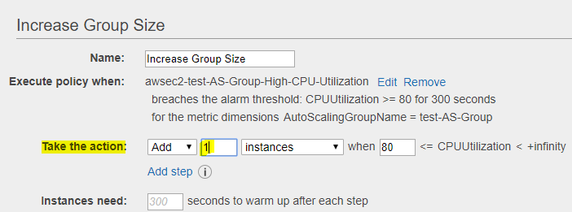

Slide 34
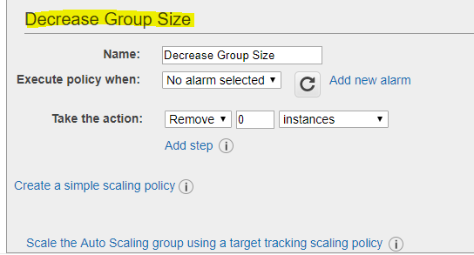
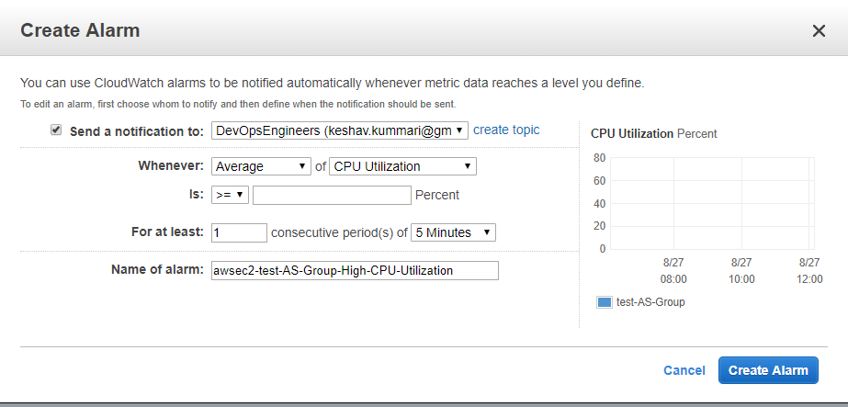

Slide 35
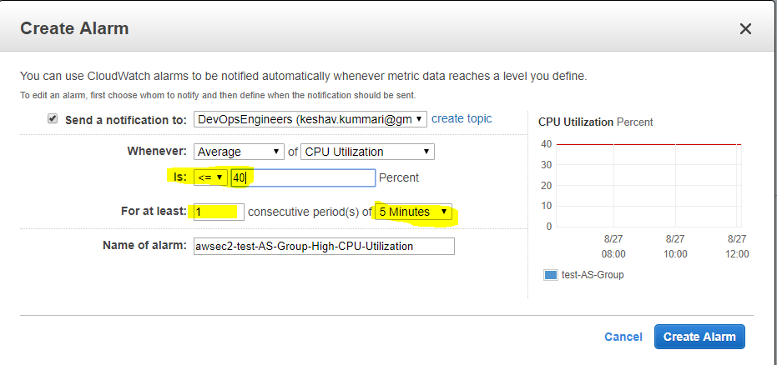
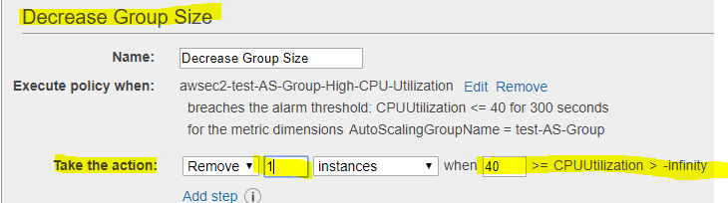

Slide 36
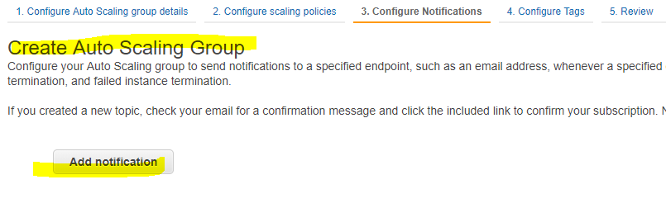
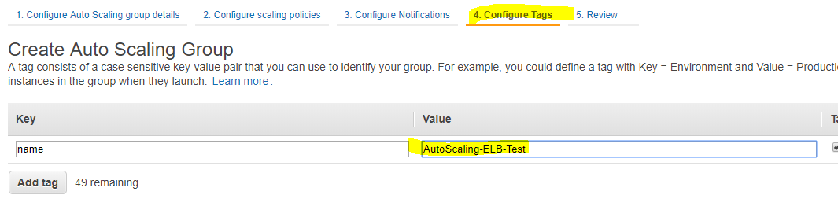
Add Notification groups if any? Or else skip

Slide 37
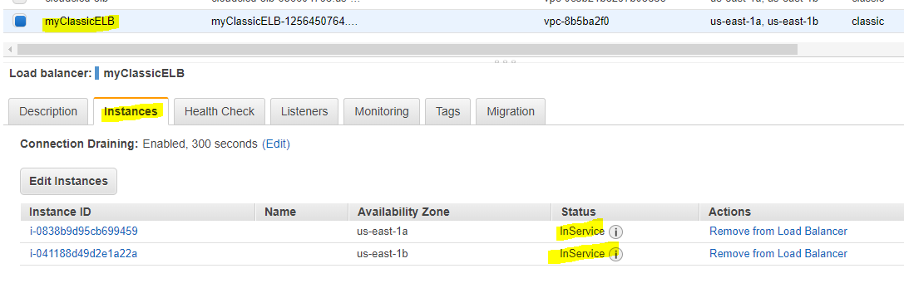
Verify the ELB & Auto Scaling

Slide 38
Cross check the ELB, EC2 instance configuration
Go to Browser and verify the ELB DNS Name
http://myclassicelb-1256450764.us-east-1.elb.amazonaws.com/
Go to Browser and verify the EC2_1 instance DNS Name/IP
http://ec2-54-85-38-140.compute-1.amazonaws.com
http://54.85.38.140
Go to Browser and verify the EC2_2 instance DNS Name/IP
http://ec2-54-198-154-106.compute-1.amazonaws.com
http://54.198.154.106

Slide 39
Auto Scaling Group CLI Commands
Auto scaling Plans:
https://docs.aws.amazon.com/cli/latest/reference/autoscaling-plans/index.html
1. create-scaling-plan
2. delete-scaling-plan
3. describe-scaling-plan-resources
4. describe-scaling-plans
5. update-scaling-plan

Slide 40
Application Auto Scaling
https://docs.aws.amazon.com/cli/latest/reference/application-autoscaling/index.html
1. delete-scaling-policy
2. delete-scheduled-action
3. deregister-scalable-target
4. describe-scalable-targets
5. describe-scaling-activities
6. describe-scaling-policies
7. describe-scheduled-actions
8. put-scaling-policy
9. put-scheduled-action
10. register-scalable-target

Slide 41
Auto Scaling https://docs.aws.amazon.com/cli/latest/reference/autoscaling/index.html
1. attach-instances
2. attach-load-balancer-target-groups
3. attach-load-balancers
4. batch-delete-scheduled-action
5. batch-put-scheduled-update-group-action
6. complete-lifecycle-action
7. create-auto-scaling-group
8. create-launch-configuration
9. create-or-update-tags
10. delete-auto-scaling-group
11. delete-launch-configuration
12. delete-lifecycle-hook
13. delete-notification-configuration
14. delete-policy
15. delete-scheduled-action
16. delete-tags
17. describe-account-limits
18. describe-adjustment-types
19. describe-auto-scaling-groups
20. describe-auto-scaling-instances

Slide 42
11. delete-launch-configuration
12. delete-lifecycle-hook
13. delete-notification-configuration
14. delete-policy
15. delete-scheduled-action
16. delete-tags
17. describe-account-limits
18. describe-adjustment-types
19. describe-auto-scaling-groups
20. describe-auto-scaling-instances
21. describe-auto-scaling-notification-types
22. describe-launch-configurations
23. describe-lifecycle-hook-types
24. describe-lifecycle-hooks
25. describe-load-balancer-target-groups
25. describe-load-balancer-target-groups
26. describe-load-balancers
27. describe-metric-collection-types
28. describe-notification-configurations
29. describe-policies
30. describe-scaling-activities
31. describe-scaling-process-types
32. describe-scheduled-actions
33. describe-tags
34. describe-termination-policy-types
35. detach-instances
36. detach-load-balancer-target-groups
37. detach-load-balancers
38. disable-metrics-collection
39. enable-metrics-collection
40. enter-standby

Slide 43
41. execute-policy
42. exit-standby
43. put-lifecycle-hook
44. put-notification-configuration
45. put-scaling-policy
46. put-scheduled-update-group-action
47. record-lifecycle-action-heartbeat
48. resume-processes
49. set-desired-capacity
50. set-instance-health
51. set-instance-protection
52. suspend-processes
53. terminate-instance-in-auto-scaling-group
54. update-auto-scaling-group

Slide 44
Thank you!

